Slide 1
Book one way outstation cab and display the lowest charges
Presented by:
Sawan Kumar - 2271259

Slide 2
Project description
The main objective of our project is to book one way outstation cab in the travel company website and display the lowest charges.
Working of the project starts with booking a SUV car from Delhi to Manali, himachal pradesh where in the future date and time is provided .The results would display the lowest charges of the car type according to the given requirements.
Finding the group gifting cards in gift cards asks to fill the card details. Providing all the details and invalid email would capture and display the error message.
Extracting all the numbers for adult persons in the hotel booking page and storing them in a list to display the same.

Slide 3
Website used https://www.makemytrip.com/
Tools/Software used :
Selenium - Portable framework for testing Web applications and automating the process.
Java - High level Programming language.
Eclipse - Integrated Development Environment for various ‘Languages’.
TestNG - Open source testing framework.
Maven - Software and project Management tool.
POM - Object repository design pattern.

Slide 4

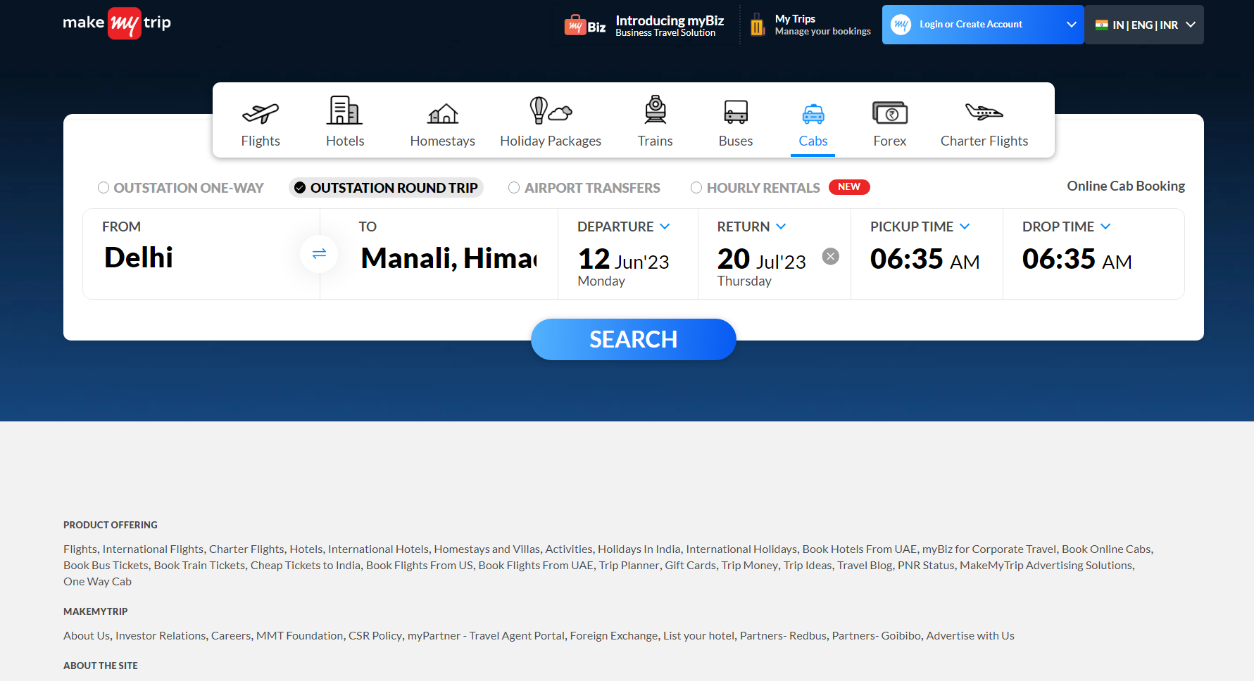
Reference screenshots of “Make my trip” website

Slide 5
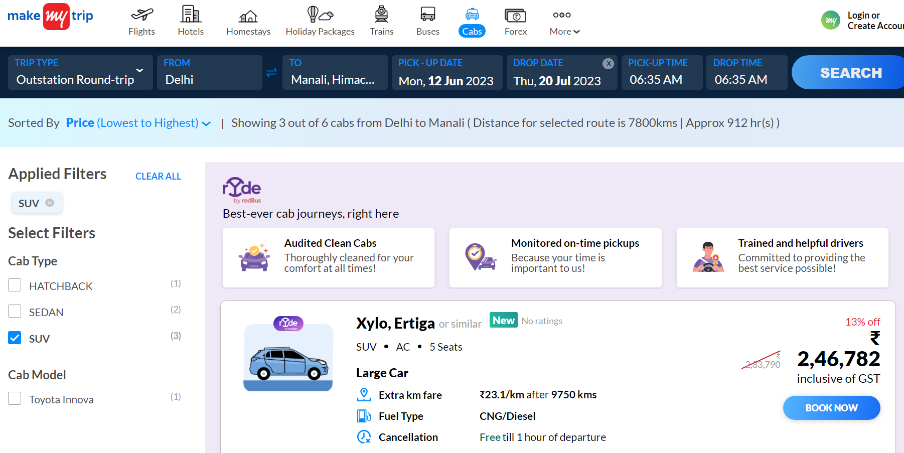

Slide 6
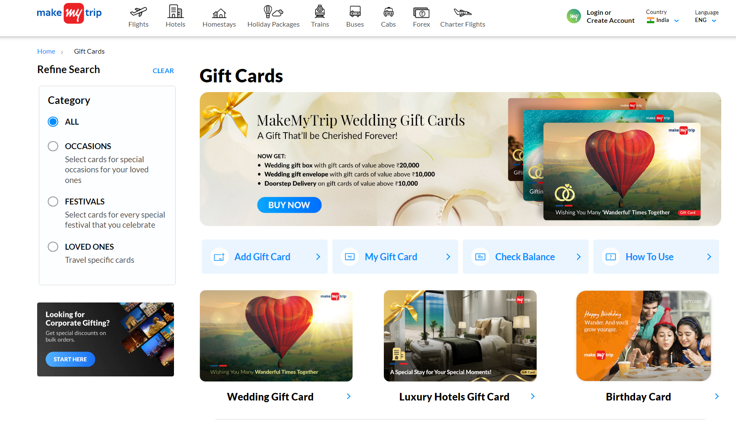

Slide 7
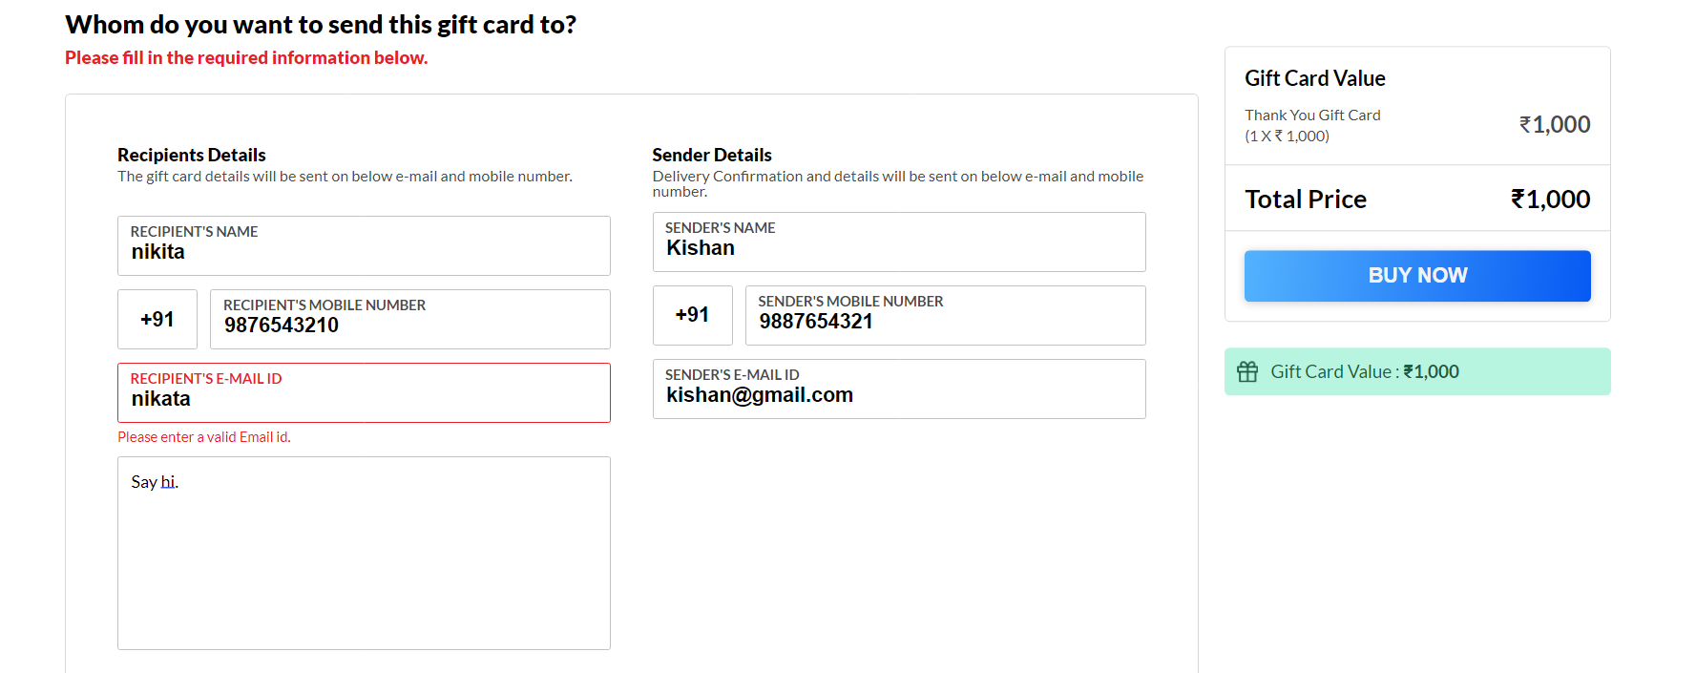

Slide 8
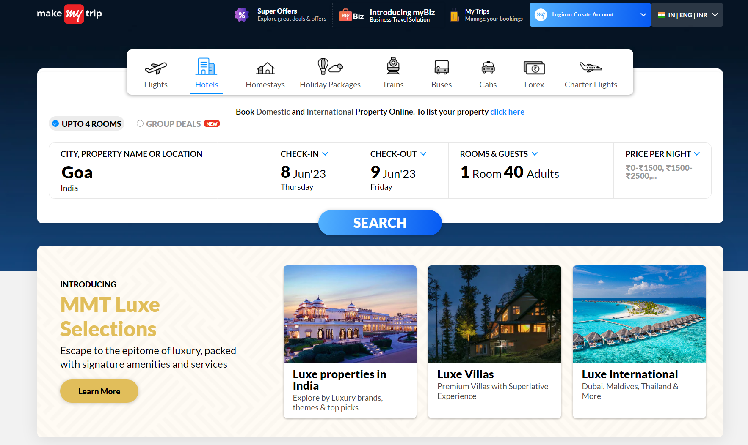

Slide 9
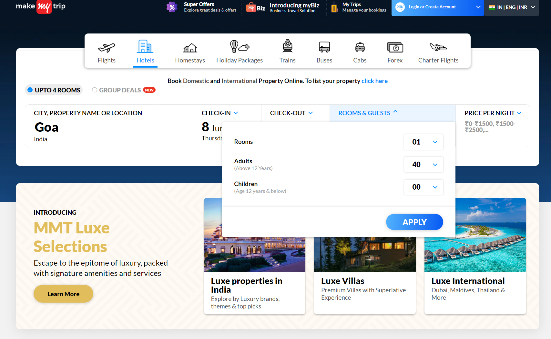

Slide 10
Automation scope
Implemented all the feasible automation concepts in the project for better project outcome.
Handled alerts wherever required.
Focused on performing the navigation between the pages.
Scrolling down the webpage.
Filling the form and capturing the warning message.
Extracting the drop down items and storing in collections.

Slide 11
Project deliverables
Tested the project manually and generated the functional testing reports.
Verified the project before starting the automation process.
Used the open source testing framework as an effective testing tool.
Utilizing Java which is a high level programming language increased the efficiency level of the project by its platform independency and easy compilation along debugging properties.
Implemented Maven in the project for managing the software and the project.
Updated the project along with the required screenshots as a reference for better understanding.
Created data-driven framework using Excel, XML and Json and handled the failed testcases.
Implemented the testing using multiple browsers(Google Chrome and Microsoft edge).
Achieved the necessary requirements and completed the project successfully which meets all its objectives.

Slide 12
Learning outcomes
We were able to perform automation testing using selenium framework and gained knowledge on working with development tools.
Learned how to use the resources more efficiently through the project implementing procedure.
We working as a team realized the importance of team work and coordinated well to make the project well organized.
We got an understanding on how to automate tests across web browsers for web applications and to ensure their high quality.
We understood that testing the progressiveness and regularity increases the proficiency and functionality of the web applications.

